Slide 1
Classless Addressing
Subnetting
https://www.omnisecu.com/tcpip/internet-layer-ip-subnetting-part3.php

Slide 2
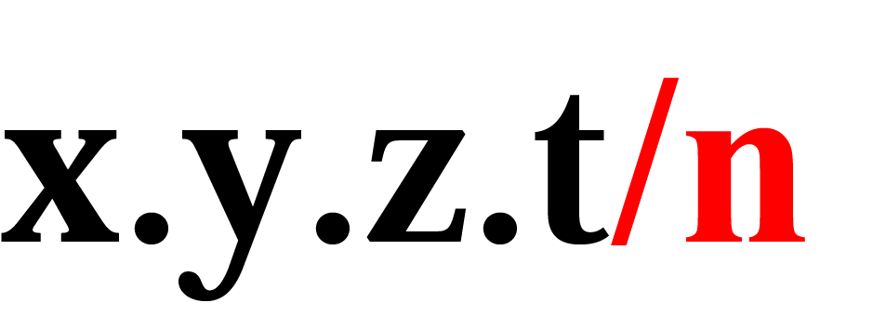
Figure 5.2 Format of classless addressing address
An address in classless addressing usually has this format:
The n after the slash defines the number of bits that are the
same in every address in the block. So if n is 20, it means
the twenty leftmost bits are identical in each address.

Slide 3
Prefix and Prefix Length
Two terms often used in classless addressing
Prefix – another name for the common part of the address range (netid)
Prefix length – the length of the prefix

Slide 4
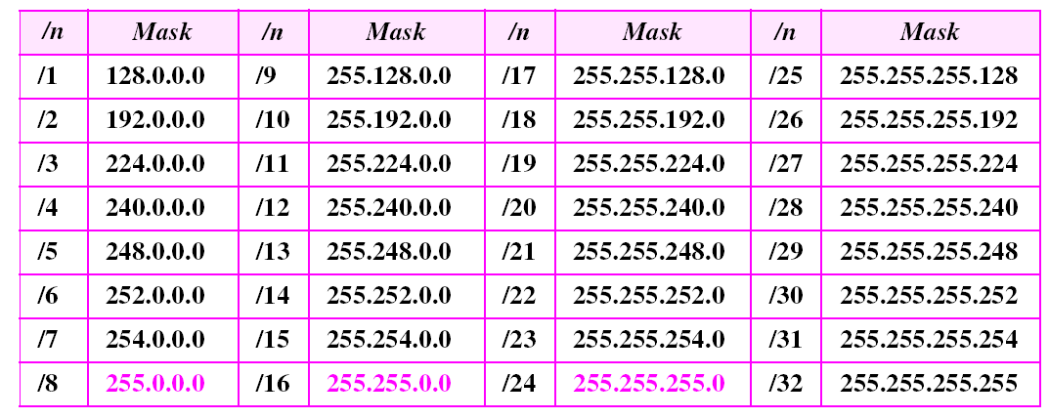
Table 5.1 Prefix lengths
The addresses in color are the default masks for classes A, B, and C.
Thus, classful addressing is a special case of classless addressing.

Slide 5
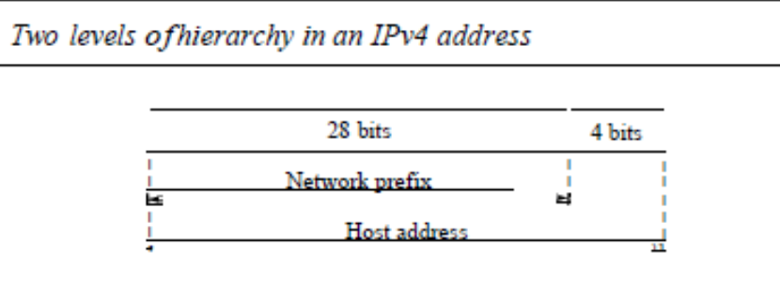
Two level Hierarchy: No Subnetting

Slide 6
Two level Hierarchy: No Subnetting
Each address in the block can be considered as a two-level hierarchical structure:
the leftmost n bits (prefix) define the network;
the rightmost 32 - n bits define the host.

Slide 7
Three-Levels of Hierarchy: Subnetting
suppose an organization is given the block 17.12.40.0/26, which
contains 64 addresses. The organization has three offices and needs to divide the
addresses into three subblocks of 32, 16, and 16 addresses.
What will be masks for three subnets i.e. /n ?
What will be Total number of addresses in each subnet?
What will be NA, BA, FA,LA and subnet mask of each subnet?
How many bits will be added from host part to prefix?

Slide 8
Example 1
An organization is granted the block 130.34.12.64/26. The organization needs 4 subnets. What is the subnet prefix length?
Solution We need 4 subnets, which means we need to add two more 1s (log₂ 4 = 2) to the site prefix. The subnet prefix is then /28.

Slide 9
Example 2
What are the subnet addresses and the range of addresses for each subnet in the previous example?
Solution Figure 5.6 shows one configuration.
See Next Slide

Slide 10
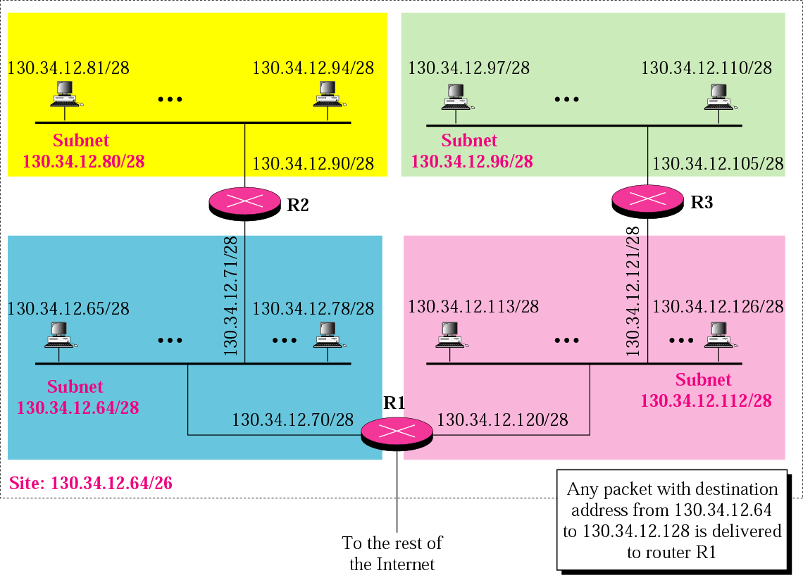
Figure 5.6 Example 2
Typo here

Slide 11
Example 2 (Continued)
The site has 2³²⁻²⁶ = 64 addresses. Each subnet has 2^{32–28} = 16 addresses. Now let us find the first and last address in each subnet.
1. The first address in the first subnet is 130.34.12.64/28, using the procedure we showed in the previous examples. Note that the first address of the first subnet is the first address of the block. The last address of the subnet can be found by adding 15 (16 −1) to the first address. The last address is 130.34.12.79/28.
See Next Slide

Slide 12
Example 2 (Continued)
2.The first address in the second subnet is 130.34.12.80/28; it is found by adding 1 to the last address of the previous subnet. Again adding 15 to the first address, we obtain the last address, 130.34.12.95/28.
3. Similarly, we find the first address of the third subnet to be 130.34.12.96/28 and the last to be 130.34.12.111/28.
4. Similarly, we find the first address of the fourth subnet to be 130.34.12.112/28 and the last to be 130.34.12.127/28.

Slide 13
One bit subnetting
Consider the example of 192.168.10.0/24 network, If we include one bit from the host part to the network part in the last octet, the default mask 255.255.255.0 is changed into 255.255.255.128.
The single bit that is added to the network part from the host part, in the last octet, can have two possible values. Those two possible values are either 0 or 1.
So we will get two subnets with one bit of subnetting

Slide 14
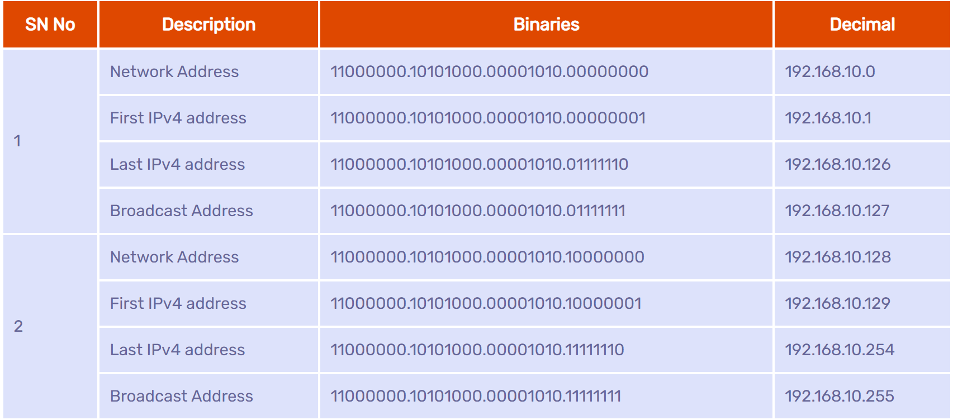
One bit subnetting

Slide 15
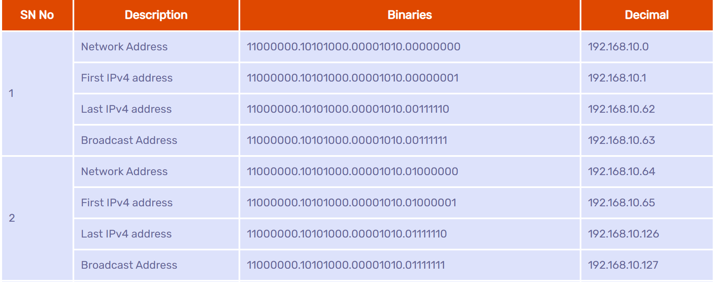
Two bit subnetting

Slide 16
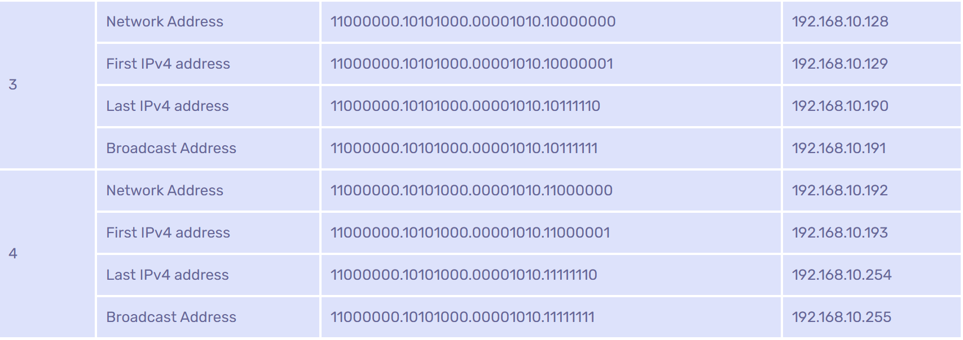
Two bit subnetting

Slide 17
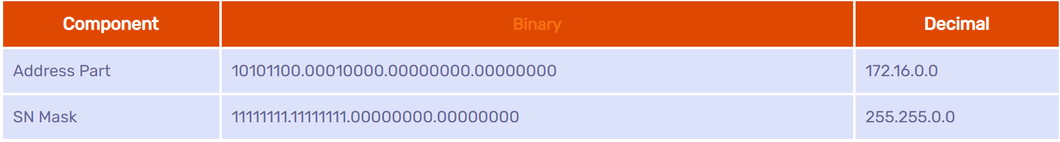
Let us consider an example of 172.16.0.0/16 - 255.255.0.0. The binary representation of the above network and its subnet mask are shown in below table.

Slide 18
If all the bits in the host part are "0", that represents the network address.
If all the bits in the host part are "0" except the last bit, it is the first usable IPv4 address.
If all the bits in the host part are "1" except the last bit, it is the last usable IPv4 address.
If all the bits in the host part are "1", that represents the directed broadcast address.

Slide 19
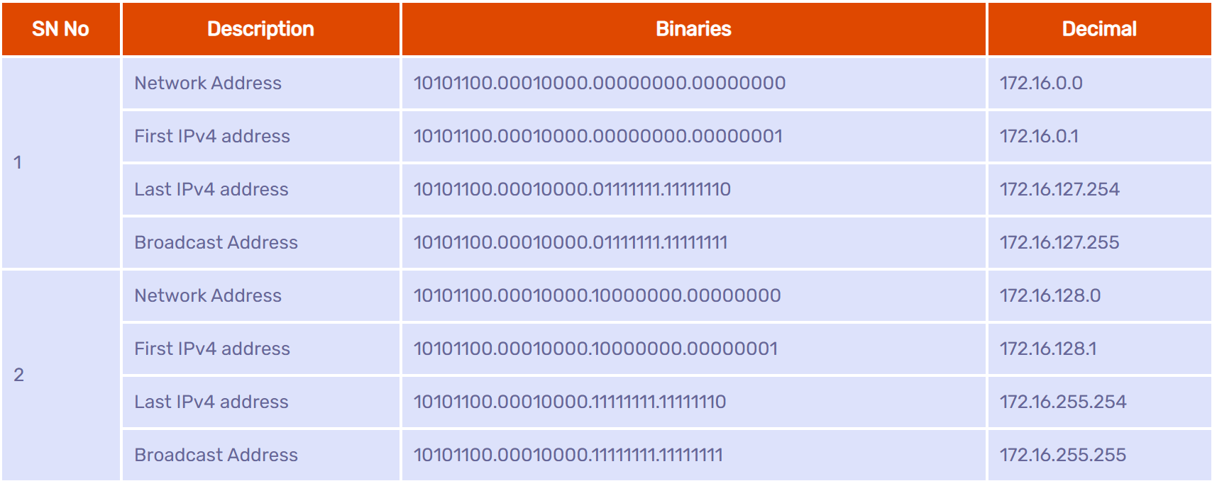
One bit subnetting – Class B

Slide 20

Two Bit Subnetting

Slide 21
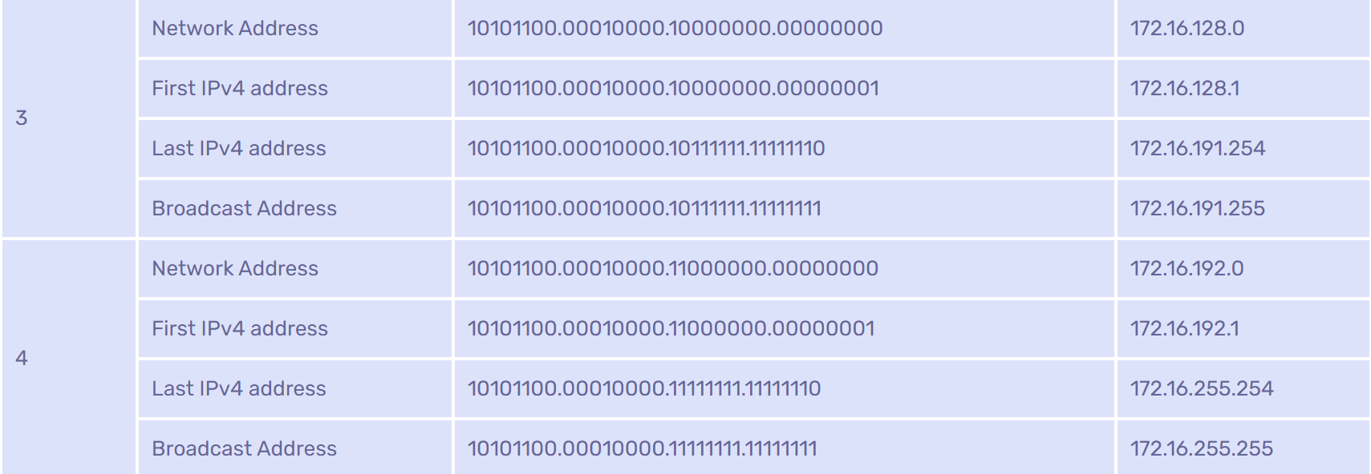
Two Bit Subnetting (cont.)

Slide 22
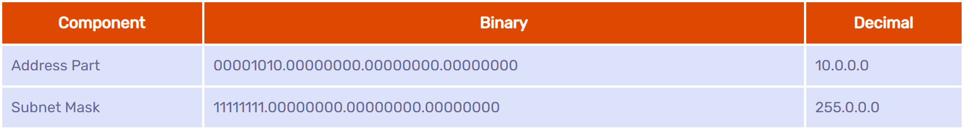
Let us consider an example of network 10.0.0.0/8 - 255.0.0.0. The binary representation of the above network and its subnet mask are shown in below table.

Slide 23
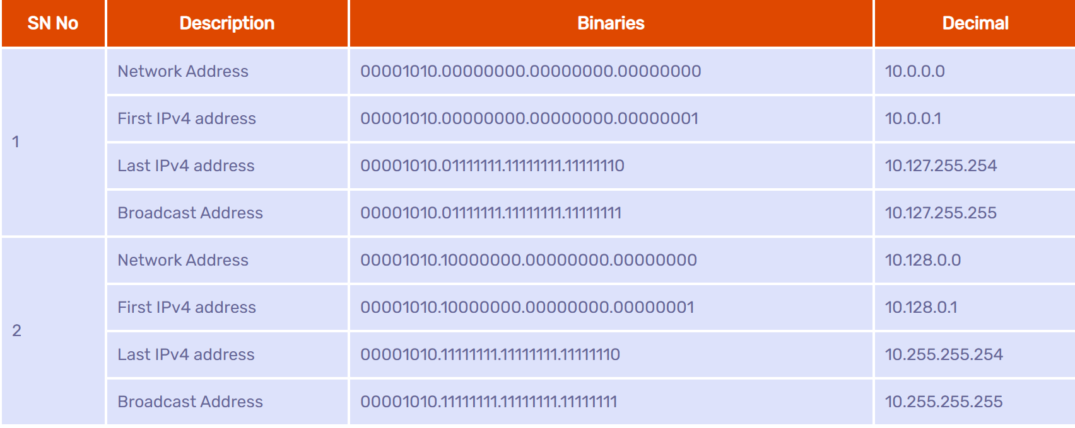
One bit subnetting

Slide 24
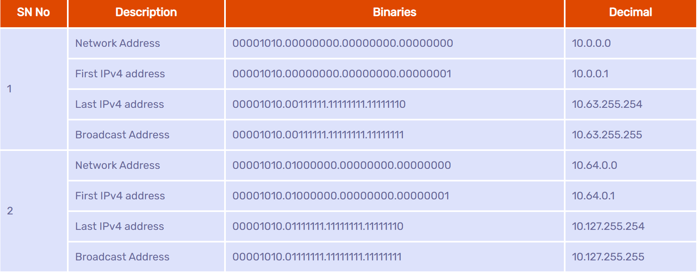
Two bit subnetting – Class A

Slide 25
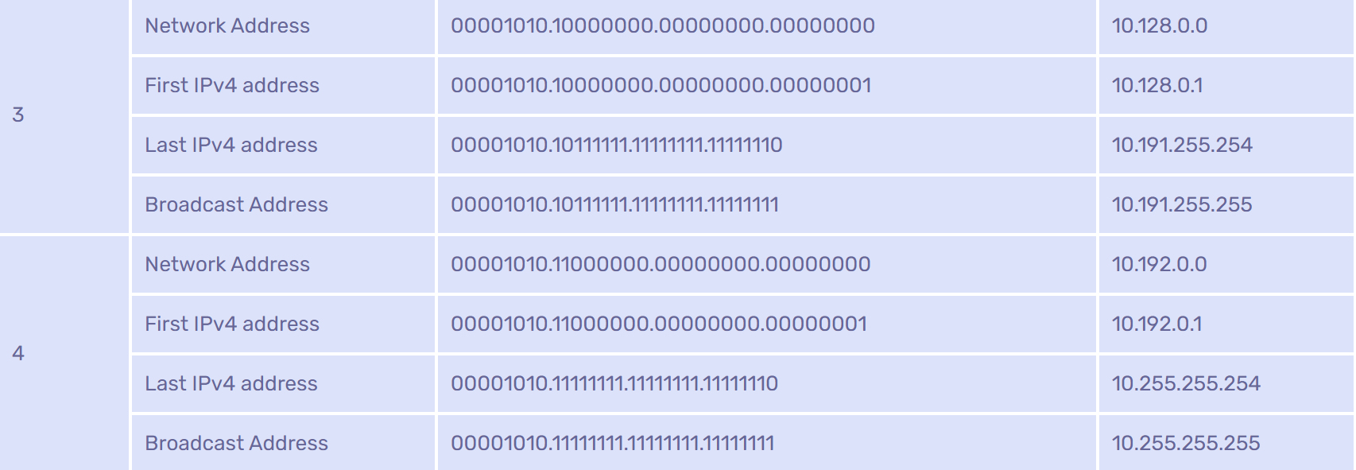
Two bit subnetting – Class A

Slide 26
Example 14
An organization is granted a block of addresses with the beginning address 14.24.74.0/24. There are 2³²⁻²⁴= 256 addresses in this block. The organization needs to have 11 subnets as shown below:
a. two subnets, each with 64 addresses.
b. two subnets, each with 32 addresses.
c. three subnets, each with 16 addresses.
d. four subnets, each with 4 addresses.
Design the subnets.
See Next Slide For One Solution

Slide 27
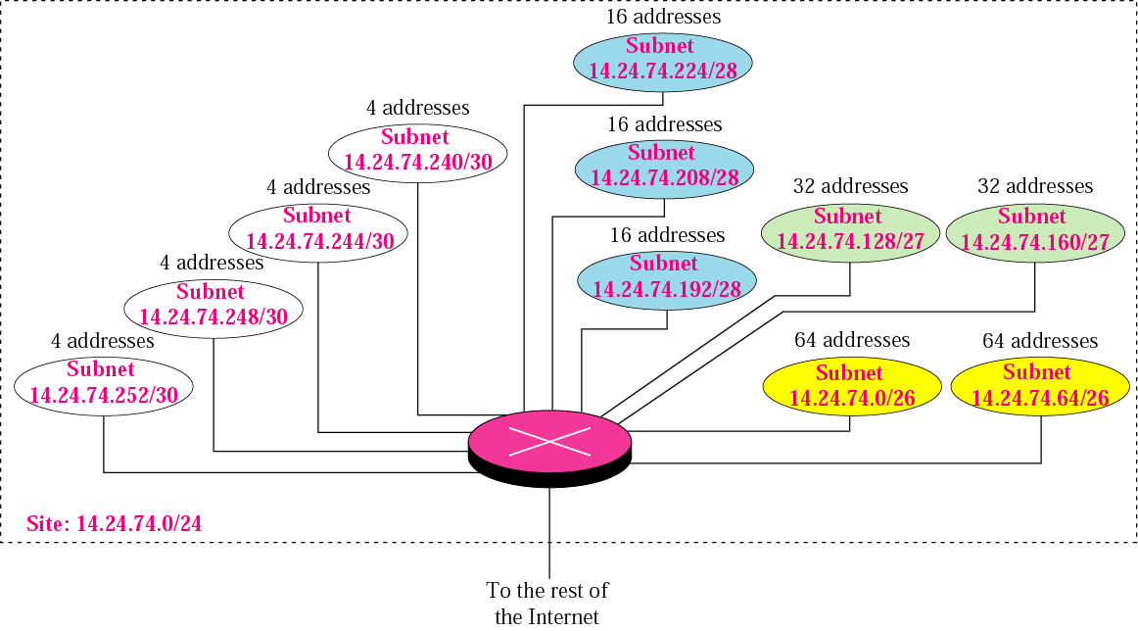
Figure 5.7 Example 14

Slide 28
Example 14 (Continuted)
1. We use the first 128 addresses for the first two subnets, each with 64 addresses. Note that the mask for each network is /26. (If each subnet needs 64 addresses, that is 2^6. 32-6 = /26) The subnet address for each subnet is given in the figure.
2. We use the next 64 addresses for the next two subnets, each with 32 addresses. Note that the mask for each network is /27. (If each subnet needs 32 addresses, that is 2^5. 32-5=/27) The subnet address for each subnet is given in the figure.
See Next Slide

Slide 29
Example 14 (Continuted)
3. We use the next 48 addresses for the next three subnets, each with 16 addresses. Note that the mask for each network is /28. The subnet address for each subnet is given in the figure.
4. We use the last 16 addresses for the last four subnets, each with 4 addresses. Note that the mask for each network is /30. The subnet address for each subnet is given in the figure.

Slide 30
Example 15
As another example, assume a company has three offices: Central, East, and West. The Central office is connected to the East and West offices via private, point-to-point WAN lines. The company is granted a block of 64 addresses with the beginning address 70.12.100.128/26. The management has decided to allocate 32 addresses for the Central office and divides the rest of addresses between the two offices. Figure 5.8 shows the configuration designed by the management.
See Next Slide

Slide 31
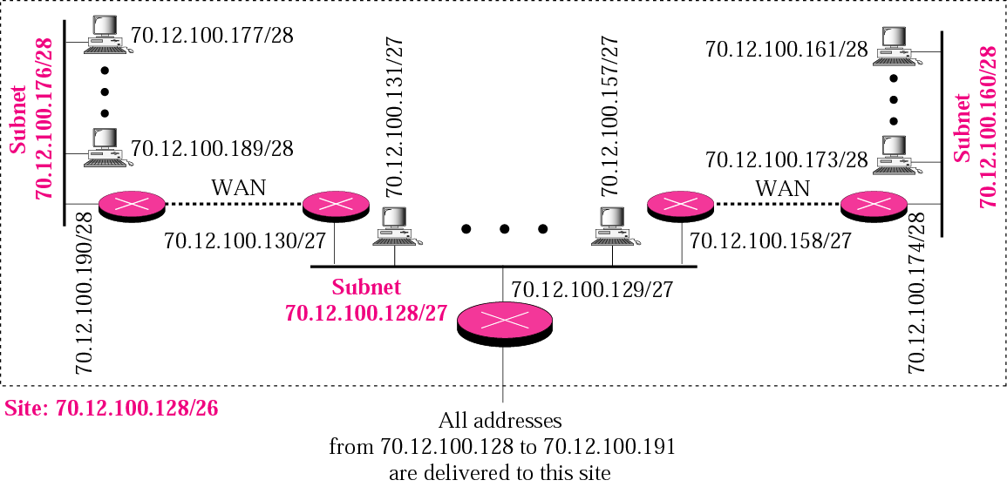
Figure 5.8 Example 15

Slide 32
Example 15 (Continued)
The company will have three subnets, one at Central, one at East, and one at West. The following lists the subblocks allocated for each network:
a. The Central office uses the network address 70.12.100.128/27. This is the first address, and the mask /27 shows that there are 32 addresses in this network. Note that three of these addresses are used for the routers and the company has reserved the last address in the sub-block. The addresses in this subnet are 70.12.100.128/27 to 70.12.100.159/27. Note that the interface of the router that connects the Central subnet to the WAN needs no address because it is a point-to-point connection.
See Next Slide

Slide 33
Example 15 (Continued)
b. The West office uses the network address 70.12.100.160/28. The mask /28 shows that there are only 16 addresses in this network. Note that one of these addresses is used for the router and the company has reserved the last address in the sub-block. The addresses in this subnet are 70.12.100.160/28 to 70.12.100.175/28. Note also that the interface of the router that connects the West subnet to the WAN needs no address because it is a point-to- point connection.
See Next Slide

Slide 34
Practice Problem
An organization is granted the block 16.0.0.0/8. The administrator wants to create 500 fixed-length subnets.
Find the subnet mask
Find the number of addresses in each subnet
Find the first and last address in the first subnet

Slide 35
5.3 ADDRESS ALLOCATION
Address allocation is the responsibility of a global authority called the Internet Corporation for Assigned Names and Addresses (ICANN). It usually assigns a large block of addresses to an ISP to be distributed to its Internet users.

Slide 36
Example 16
An ISP is granted a block of addresses starting with 190.100.0.0/16 (65,536 addresses). The ISP needs to distribute these addresses to three groups of customers as follows:
a. The first group has 64 customers; each needs 256 addresses. b. The second group has 128 customers; each needs 128 addresses c. The third group has 128 customers; each needs 64 addresses.
See Next Slide

Slide 37
Example 16 (Continued)
Design the subblocks and find out how many addresses are still available after these allocations.
Solution Figure 5.9 shows the situation.
See Next Slide

Slide 38
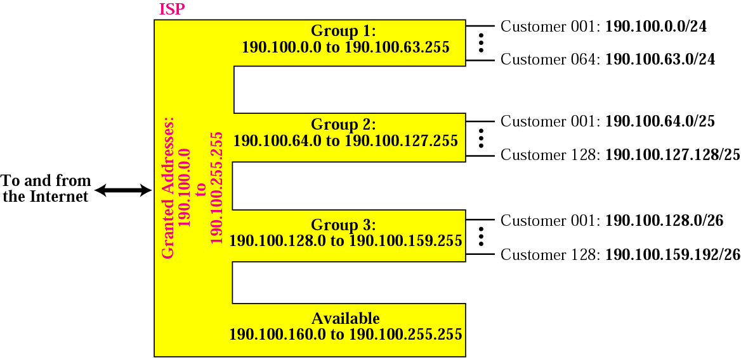
Figure 5.9 Example 16

Slide 39
Example 16 (Continued)
Group 1 For this group, each customer needs 256 addresses. This means the suffix length is 8 (2⁸ =256). The prefix length is then 32 − 8 = 24. The addresses are:
1st Customer 190.100.0.0/24 190.100.0.255/24 2nd Customer 190.100.1.0/24 190.100.1.255/24 . . . 64th Customer 190.100.63.0/24 190.100.63.255/24 Total = 64 × 256 = 16,384
See Next Slide

Slide 40
Example 16 (Continued)
Group 2 For this group, each customer needs 128 addresses. This means the suffix length is 7 (2⁷ =128). The prefix length is then 32 − 7 = 25. The addresses are:
1st Customer 190.100.64.0/25 190.100.64.127/25 2nd Customer 190.100.64.128/25 190.100.64.255/25 · · · 128th Customer 190.100.127.128/25 190.100.127.255/25
Total = 128 × 128 = 16,384
See Next Slide

Slide 41
Example 16 (Continued)
Group 3 For this group, each customer needs 64 addresses. This means the suffix length is 6 (26 = 64). The prefix length is then 32 − 6 = 26. The addresses are:
1st Customer 190.100.128.0/26 190.100.128.63/26
2nd Customer 190.100.128.64/26 190.100.128.127/26 · · · 128th Customer 190.100.159.192/26 190.100.159.255/26
Total = 128 × 64 = 8,192
See Next Slide

Slide 42
Example 16 (Continued)
Number of granted addresses to the ISP: 65,536
Number of allocated addresses by the ISP: 40,960
Number of available addresses: 24,576

